Slide 1
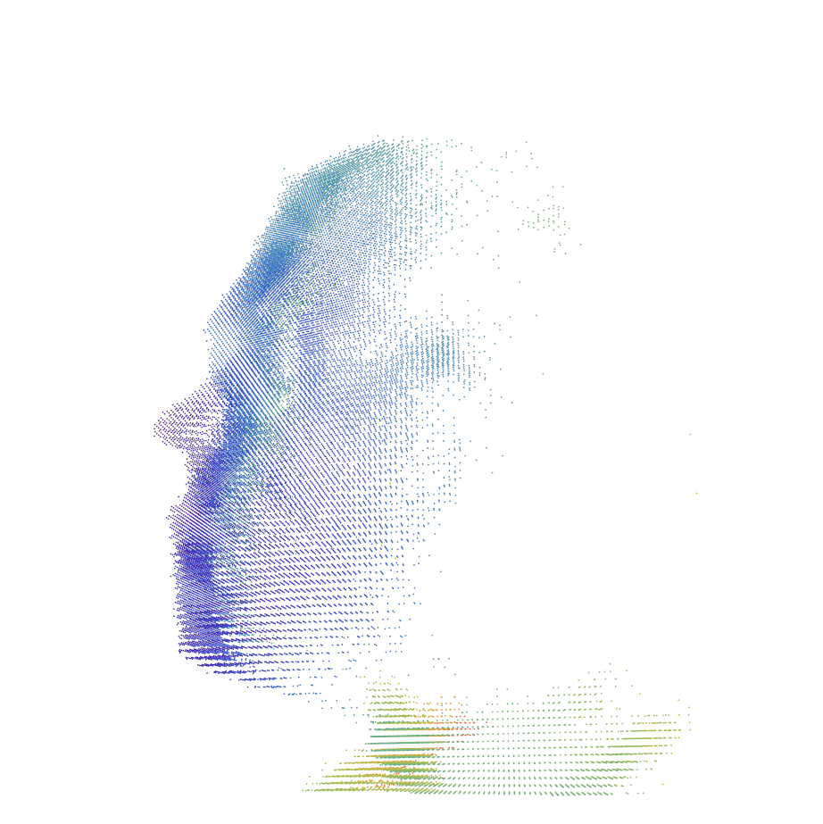
Saving Face
Elegant Facial Recognition

Slide 2
Requirements and Features
Feature List:
Story Name | Description | NUTS
Fixed Point Orientation | Find X Y Z of at least three fixed points; Or 1 and Yaw Pitch and Roll | 2
Transform Module | A module that applies the transform to bring the points into a common plane | 6
Build Model Module | A module that takes the transformed data and makes a model representation | 5
Compare Module | A Module that takes a stream and compares it to a list of Models and returns a ranking | 5
Load Module | Load a model from a file | 2
Save Module | Saves a model to a file | 2
Debug Terminal | Displays Helpful Information | 2
Save Depth and Color Video | A module that saves video for later re-use | 4
Display Streams | A module that displays depth and color Streams | 1
User Information Input | A GUI interface for inputting model Information | 3
Save Image Data | A module To Save a User Photo for Later Display | 2
Load Color/Depth Video | A module to load video playback for algorithm refinement and debugging | 4
Load User Image | A module to load and display a user image | 2
Activity: Model Collection | Collect model data to test accuracy of implementation | 3

Slide 3
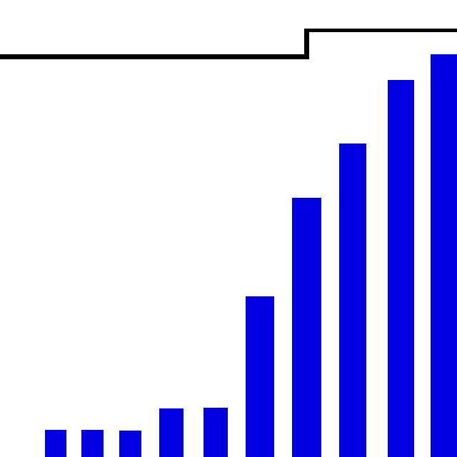
Burn up Chart

Slide 4
Design and Algorithms
Designs were first created as theoretic models from group discussions.
Then early designs work created, and tested in Mathmatica.
The objects and algorithms were then implemented in C++

Slide 5
Generic Algorithm for the Model Construction
While[Frames < N]
Read in byte stream
Get Fixed Point, and Yaw Pitch and Roll From SDK
Calculate Transformation Matrix Based On Yaw Pitch and Roll
Determine Relative Location Of Head
For[Vertices]
Apply Linear Transform to bring point relative to origin
Apply Rotational Transform To Align Head
Map Point to Model Byte[]
Increase that point by one
Save Model
End

Slide 6
One Generic Algorithm for the Model Comparison
score[Len(Model)]
For[each Vertex v] //Vertex is found
For[each Model m] //For All Models
If[m[v] > 0] //contains a data point
score[m] += m[v] //count of vertex hits
For[each score s]
s[m].pct = s[m].total/m.total
return score;
End

Slide 7
Saving Face: Product Description
Saving Face is an application designed to build and compare 3D models using the Intel Creative Camera, by taking depth images of a user's face and building a comparable 3D model of them. The software is designed to test the feasibility of using the Intel Creative Camera for facial recognition.

Slide 8
Data Collection
Collect user information
Capture a picture of the user
Capture a set number of frames of depth data

Slide 9
Model Creation
Combine the vertex information from the depth frames collected into a sigle model.
Store the depth frames in a byte array so each byte represents a range of space.
Using the pitch, roll and yaw of the user’s head, as well as the location of the tip of the nose translate the model to a standard angel, and locate the nose at the origin or our 3D space.

Slide 10
Model Storage
The user information, picture, and 3D model are stored in a database for future reference.
Model Comparison
Each vertex of the identification model is compared to the vertices of the reference models.
The number of matches are recorded and divided by the number of vertices per model to give a matching percent.
The higher the percent match, the more likely the user was found in the database.

Slide 11
Testing: Saving Face
The project employed automated testing via the Visual Studio 2012 Professional Suite for unmanaged C++ code.
Individual tests were written for each section of code that could be independently tested.

Slide 12
Software Engineering and Team Process
The Agile Method was used as the model for our project. As time past, we could see we needed to put more effort into the completion of the project, and the application of the Agile process became less formal as a result of our desire to finish the project on time.
Regular team meetings where held to discus the project and ideas for the project, as well as frequent emails with updates on the project as well as questions for other team members.

Slide 13
Who worked on what
There was a tremendous amount of cross over on who worked on what. All parts of the project were a team effort. At times, through a lack of communication, we were working on the same pieces of code at the same time.
As to primary tasks
Keith Schneider: Preliminary model design and testing and PC-SDK implementation.
Andrew Mason: PC-SDK implementation, GUI design, documentation.
Jacob Dempsey: GUI design and implementation, documentation.

Slide 14
Project Insights
More time spent on project design up front may have allowed better distribution of tasks.
However, having multiple people working on the same task allowed for more creative, and better solutions to challenges.
Communication is vital to the success of the project.

